Slide 1
Software processes
Unit 2
Prepared by: Natabar Khatri
New Summit College

Slide 2
Software process
A software process is a set of related activities required to develop high-quality software systems.
organizations tailor their approaches based on factors such as:
Project complexity (small app vs. enterprise system)
Customer needs (fixed requirements vs. evolving demands)
Team expertise (experienced engineers vs. distributed teams)
Regulatory constraints (safety-critical systems vs. consumer apps)
Despite this variability, all effective software processes incorporate the following four core engineering activities:
Software Specification (Requirements Engineering)
Software Development (Design & Implementation)
Software Validation (Testing & Quality Assurance)
Software Evolution (Maintenance & Updates)

Slide 3
Software process
Software Specification (Requirements Engineering)
Defines what the software should do and its operational constraints.
Task involved:
Gathering and analyzing stakeholder needs
Documenting functional & non-functional requirements
Prioritizing features based on business goals
Outputs:
Software Requirements Specification (SRS)
Use case diagrams

Slide 4
Software process
Software Development (Design & Implementation)
Transforms requirements into a working system.
Task involved:
Architectural design (system structure, components)
Detailed design (algorithms, database schemas)
Coding (following best practices like clean code, SOLID principles)
Outputs:
Design documents (UML diagrams, ER models)
Source code
APIs and microservices (if applicable)

Slide 5
Software process
Software Validation (Testing & Quality Assurance)
Purpose: Ensure the software meets specifications and is defect-free.
Key Tasks:
Unit testing (individual components)
Integration testing (interactions between modules)
System & acceptance testing (end-to-end validation)
Outputs:
Test cases and reports
Bug-fix logs
Performance benchmarks

Slide 6
Software process
Software Evolution (Maintenance & Updates)
Purpose: Adapt the software to changing needs over time.
Key Tasks:
Corrective maintenance (fixing defects)
Adaptive maintenance (updating for new environments)
Perfective maintenance (enhancing features)
Outputs: Patches and updates
Versioned releases
Refactored code

Slide 7
Software process Models
Software process models (or SDLC model) provide structured approaches to developing software systems. It is a blueprints that guide teams through the stages of SDLC models.
The general process models that we are going to study:
The Waterfall Model
Incremental Development
Integration & Configuration (Reuse-Oriented Model)
Hybrid Approaches

Slide 8
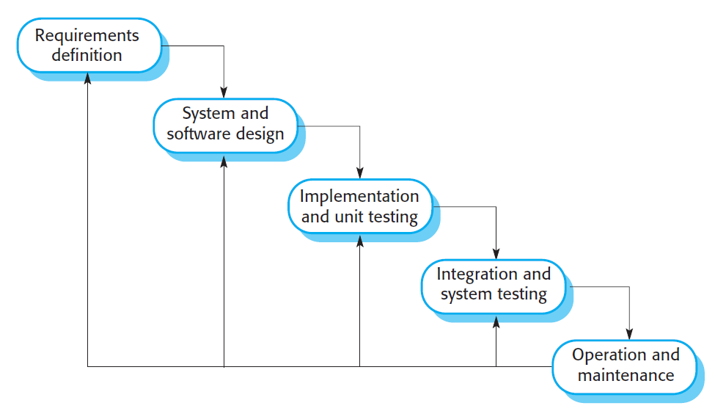
The waterfall model
The Waterfall Model is a linear, sequential approach where each phase must be completed before moving to the next. It aligns closely with the fundamental software engineering activities:
Requirements Definition
System & Software Design
Implementation & Unit Testing
Integration & System Testing
Operation & Maintenance

Slide 9
phases of waterfall model
Requirements analysis and definition:
Objective: Establish system functionalities, constraints, and goals.
Activities:
Gather stakeholder needs through consultations.
Document detailed Software Requirements Specification (SRS).
Output: Approved requirements document.
System and software design:
Objective: Translate requirements into architecture and design.
Activities:
Allocate functions to hardware/software.
Create system architecture diagrams (e.g., UML).
Define data structures, algorithms, and interfaces.
Output: Design specification documents.

Slide 10
Software process Models
Implementation and unit testing:
Objective: Develop and test individual software components.
Activities:
Write code following design specs.
Conduct unit testing (e.g., JUnit for Java).
Output: Functional program units.
Integration and system testing:
Objective: Combine modules and validate the full system.
Activities:
Integrate units into a complete system.
Perform system, performance, and acceptance testing.
Output: Tested, deployable software.

Slide 11
Software process Models
Operation & Maintenance
Objective: Deploy, monitor, and improve the system.
Activities:
Fix bugs (corrective maintenance).
Adapt to new environments (adaptive maintenance).
Add features (perfective maintenance).
Output: Updated software versions.

Slide 12
Waterfall Model
When to use Waterfall Model?
Projects with stable and well-defined requirements
Low uncertainty (minimal expected changes during development).
Regulated industries (where documentation is mandatory)
In case of Safety-critical systems (e.g., medical devices, avionics) and Large-scale engineering projects (e.g., hardware-software integration).
The Waterfall Model remains relevant for high-certainty, regulated, or safety-critical projects where upfront planning is essential

